Slide 1
Alexandria Central School District
2022-2023 Budget Update
March 22, 2022

Slide 2
Let’s Recap…

Slide 3
January 25, 2022
Budgeted Expenditures = $15,107,019
Increase $875,833 (6.15%)
State Aid Increase = $102,693
Initial Gap = $859,462

Slide 4
February 15, 2022
Tax Cap = 3.95%
Started to close the gap:
Updated Expenditures = $14,944,306
Appropriated Fund Balance $850,000 → $1,350,000

Slide 5
February 15, 2022
New Revenue Sources:
Village of A Bay
Hammond CSD
Updated Gap = $73,667

Slide 6
Don’t Forget
Instructional Increase
3.30%
Non-Instructional Increase
3.25%
Health Insurance Increase
7.00%
TRS Increase
5.00%
ERS Decrease
28.42% -- Effective February 2023

Slide 7
What’s New?

Slide 8
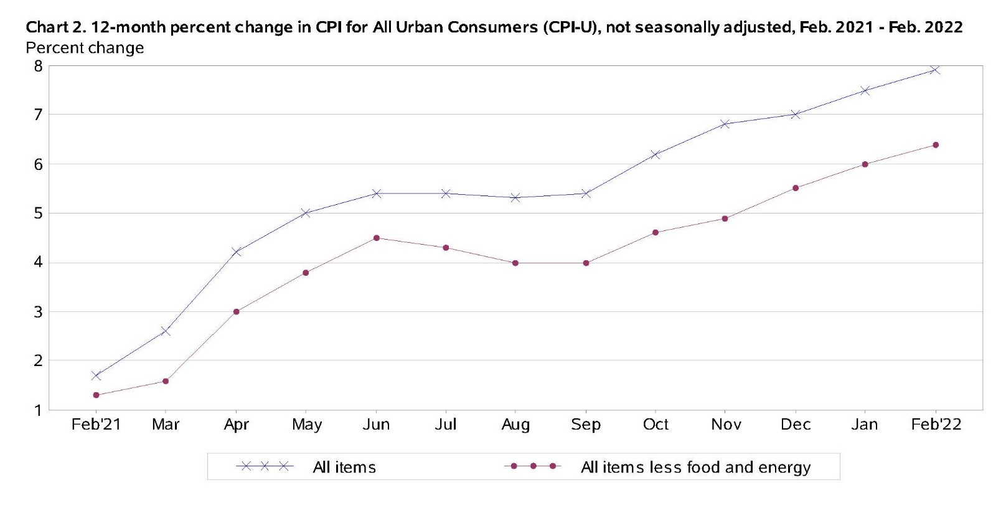

Slide 9
Fuel, Gas
Heating Oil – Main Building
$1.8331 → $2.6065 = 42.19%
Heating Oil – Garage
$2.1990 → $2.8910 = 31.47%
Diesel
$2.2980 → $3.0871 = 34.34%
Gasoline
30–40% Increase as per Fin’l Advisors

Slide 10
Electric
102.45% increase
Solar Refund:
2020 = $1,087.48
2021 = $1,425.32
On track for highest revenue to date for 2022

Slide 11
BOCES
Administration
$96,922 → $105,141 = 8.48%
Facility Rental
$11,093 → $11,518 = 3.83%
Distance Learning
$18,215 → $18,840 = 3.43%

Slide 12
BOCES (cont’d)
One to One Aides
$40,579 → $42,872 = 5.70%
CTE Program
$9,745/pupil → $10,121/pupil = 3.85%

Slide 13
Trash Removal
6 Yard Dumpster Svc: 18.00%
8 Yard Dumpster Svc: 9.20%
Fuel / Environmental Charge: 109.14%

Slide 14
Food
Millers Meat Market = 22.57%
USDA Supplement Expected to End June 30
Increase in Supplement from General Fund
$75,000 → $100,000

Slide 15
Where Are We Now?

Slide 16
March 22, 2022
Budgeted Expenditures = $15,030,670
Increase $813,573 (5.62%)
Tax Cap = 3.95%
Proposing Tax Levy = 3.90%

Slide 17
EXAMPLE BASED ON LAST YEAR'S ASSESSED VALUES & EQUALIZATION RATES
 |  | Property Assessment Value
 |  | $50,000 | $100,000 | $150,000 | $200,000
 | 1.0% | $6.48 | $12.97 | $19.45 | $25.93
 | 2.0% | $12.97 | $25.93 | $38.90 | $51.87
 | 3.0% | $19.45 | $38.90 | $58.35 | $77.80
 | 3.9% | $25.28 | $50.57 | $75.85 | $101.14

